Slide 1
Introduction to Probability Theory
Rong Jin

Slide 2
Outline
Basic concepts in probability theory
Bayes’ rule
Random variable and distributions

Slide 3

Definition of Probability
Experiment: toss a coin twice
Sample space: possible outcomes of an experiment
  S = {HH, HT, TH, TT}
Event: a subset of possible outcomes
  A={HH}, B={HT, TH}
Probability of an event : an number assigned to an event Pr(A)
  Axiom 1: Pr(A) ≥ 0
  Axiom 2: Pr(S) = 1
  Axiom 3: For every sequence of disjoint events
  Example: Pr(A) = n(A)/N: frequentist statistics

Slide 4
Joint Probability
For events A and B, joint probability Pr(AB) stands for the probability that both events happen.
Example: A={HH}, B={HT, TH}, what is the joint probability Pr(AB)?

Slide 5
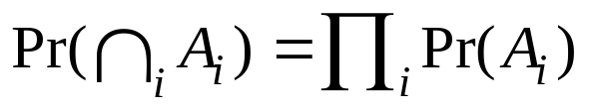
Independence
Two events A and B are independent in case
  Pr(AB) = Pr(A)Pr(B)
A set of events {A_{i}} is independent in case

Slide 6
Independence
Two events A and B are independent in case
  Pr(AB) = Pr(A)Pr(B)
A set of events {A_{i}} is independent in case
Example: Drug test
A = {A patient is a Women}
B = {Drug fails}
Will event A be independent from event B ?
 | Women | Men
Success | 200 | 1800
Failure | 1800 | 200

Slide 7
Independence
Consider the experiment of tossing a coin twice
Example I:
  A = {HT, HH}, B = {HT}
  Will event A independent from event B?
Example II:
  A = {HT}, B = {TH}
  Will event A independent from event B?
Disjoint ≠ Independence
If A is independent from B, B is independent from C, will A be independent from C?

Slide 8
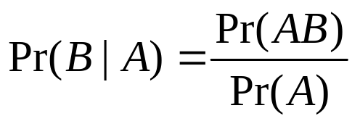
Conditioning
If A and B are events with Pr(A) > 0, the conditional probability of B given A is

Slide 9
Conditioning
If A and B are events with Pr(A) > 0, the conditional probability of B given A is
Example: Drug test
A = {Patient is a Women}
B = {Drug fails}
Pr(B|A) = ?
Pr(A|B) = ?
 | Women | Men
Success | 200 | 1800
Failure | 1800 | 200

Slide 10
Conditioning
If A and B are events with Pr(A) > 0, the conditional probability of B given A is
Example: Drug test
Given A is independent from B, what is the relationship between Pr(A|B) and Pr(A)?
A = {Patient is a Women}
B = {Drug fails}
Pr(B|A) = ?
Pr(A|B) = ?
 | Women | Men
Success | 200 | 1800
Failure | 1800 | 200

Slide 11
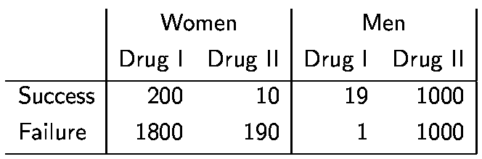
Which Drug is Better ?

Slide 12
Simpson’s Paradox: View I
Drug II is better than Drug I
A = {Using Drug I}
B = {Using Drug II}
C = {Drug succeeds}
Pr(C|A) ~ 10%
Pr(C|B) ~ 50%
 | Drug I | Drug II
Success | 219 | 1010
Failure | 1801 | 1190

Slide 13
Simpson’s Paradox: View II
Female Patient
A = {Using Drug I}
B = {Using Drug II}
C = {Drug succeeds}
Pr(C|A) ~ 20%
Pr(C|B) ~ 5%

Slide 14
Simpson’s Paradox: View II
Female Patient
A = {Using Drug I}
B = {Using Drug II}
C = {Drug succeeds}
Pr(C|A) ~ 20%
Pr(C|B) ~ 5%
Male Patient
A = {Using Drug I}
B = {Using Drug II}
C = {Drug succeeds}
Pr(C|A) ~ 100%
Pr(C|B) ~ 50%

Slide 15
Simpson’s Paradox: View II
Drug I is better than Drug II
Female Patient
A = {Using Drug I}
B = {Using Drug II}
C = {Drug succeeds}
Pr(C|A) ~ 20%
Pr(C|B) ~ 5%
Male Patient
A = {Using Drug I}
B = {Using Drug II}
C = {Drug succeeds}
Pr(C|A) ~ 100%
Pr(C|B) ~ 50%

Slide 16
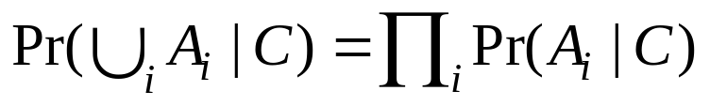
Conditional Independence
Event A and B are conditionally independent given C in case
Pr(AB|C)=Pr(A|C)Pr(B|C)
A set of events {A_{i}} is conditionally independent given C in case

Slide 17
Conditional Independence (cont’d)
Example: There are three events: A, B, C
  Pr(A) = Pr(B) = Pr(C) = 1/5
  Pr(A,C) = Pr(B,C) = 1/25, Pr(A,B) = 1/10
  Pr(A,B,C) = 1/125
  Whether A, B are independent?
  Whether A, B are conditionally independent given C?
A and B are independent ≠ A and B are conditionally independent

Slide 18
Outline
Important concepts in probability theory
Bayes’ rule
Random variables and distributions

Slide 19
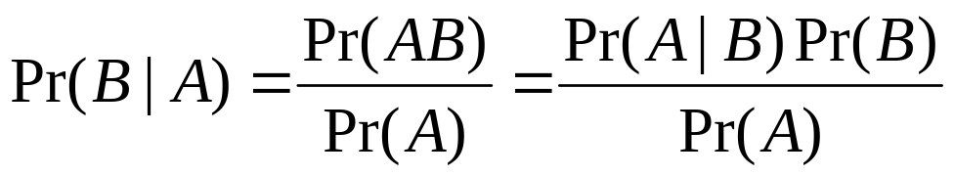
Bayes’ Rule
Given two events A and B and suppose that Pr(A) > 0. Then
Example:
Pr(R) = 0.8
R: It is a rainy day
W: The grass is wet
Pr(R|W) = ?
Pr(W|R) | R | ¬R
W | 0.7 | 0.4
¬W | 0.3 | 0.6

Slide 20
Bayes’ Rule
 | R | ¬R
W | 0.7 | 0.4
¬W | 0.3 | 0.6
R: It rains
W: The grass is wet
Information
Pr(W|R)
R
W
Inference
Pr(R|W)

Slide 21
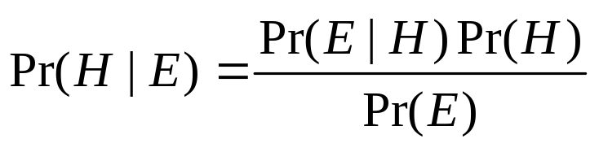
Bayes’ Rule
 | R | ¬R
W | 0.7 | 0.4
¬W | 0.3 | 0.6
R: It rains
W: The grass is wet
Information: Pr(E|H)
Hypothesis H
Evidence E
Posterior
Likelihood
Prior
Inference: Pr(H|E)

Slide 22

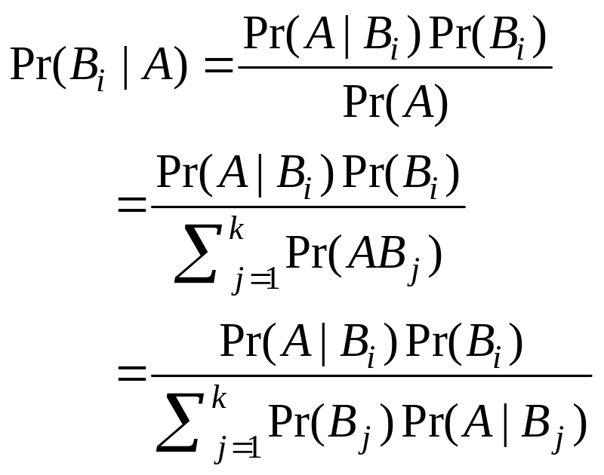
Bayes’ Rule: More Complicated
Suppose that B₁, B₂, … B_{k} form a partition of S:
Suppose that Pr(B_{i}) > 0 and Pr(A) > 0. Then

Slide 23
Bayes’ Rule: More Complicated
Suppose that B₁, B₂, … B_{k} form a partition of S:
Suppose that Pr(B_{i}) > 0 and Pr(A) > 0. Then

Slide 24
Bayes’ Rule: More Complicated
Suppose that B₁, B₂, … B_{k} form a partition of S:
Suppose that Pr(B_{i}) > 0 and Pr(A) > 0. Then

Slide 25
A More Complicated Example
R | It rains
W | The grass is wet
U | People bring umbrella
Pr(UW|R)=Pr(U|R)Pr(W|R) Pr(UW| ¬R)=Pr(U| ¬R)Pr(W| ¬R)
R
W
U
Pr(R) = 0.8
Pr(W|R) | R | ¬R
W | 0.7 | 0.4
¬W | 0.3 | 0.6
Pr(U|R) | R | ¬R
U | 0.9 | 0.2
¬U | 0.1 | 0.8
Pr(U|W) = ?

Slide 26
A More Complicated Example
R | It rains
W | The grass is wet
U | People bring umbrella
Pr(UW|R)=Pr(U|R)Pr(W|R) Pr(UW| ¬R)=Pr(U| ¬R)Pr(W| ¬R)
R
W
U
Pr(R) = 0.8
Pr(W|R) | R | ¬R
W | 0.7 | 0.4
¬W | 0.3 | 0.6
Pr(U|R) | R | ¬R
U | 0.9 | 0.2
¬U | 0.1 | 0.8
Pr(U|W) = ?

Slide 27
A More Complicated Example
R | It rains
W | The grass is wet
U | People bring umbrella
Pr(UW|R)=Pr(U|R)Pr(W|R) Pr(UW| ¬R)=Pr(U| ¬R)Pr(W| ¬R)
R
W
U
Pr(R) = 0.8
Pr(W|R) | R | ¬R
W | 0.7 | 0.4
¬W | 0.3 | 0.6
Pr(U|R) | R | ¬R
U | 0.9 | 0.2
¬U | 0.1 | 0.8
Pr(U|W) = ?

Slide 28
Outline
Important concepts in probability theory
Bayes’ rule
Random variable and probability distribution

Slide 29

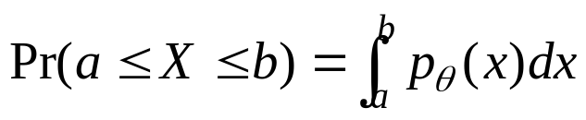
Random Variable and Distribution
A random variable X is a numerical outcome of a random experiment
The distribution of a random variable is the collection of possible outcomes along with their probabilities:
  Discrete case:
  Continuous case:

Slide 30
Random Variable: Example
Let S be the set of all sequences of three rolls of a die. Let X be the sum of the number of dots on the three rolls.
What are the possible values for X?
Pr(X = 5) = ?, Pr(X = 10) = ?

Slide 31
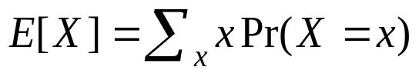
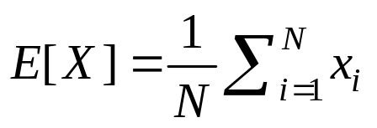
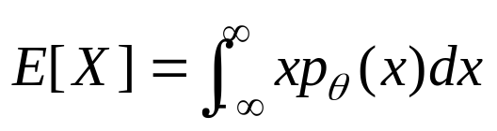

Expectation
A random variable X~Pr(X=x). Then, its expectation is
  In an empirical sample, x1, x2,…, xN,
Continuous case:
Expectation of sum of random variables

Slide 32
Expectation: Example
Let S be the set of all sequence of three rolls of a die. Let X be the sum of the number of dots on the three rolls.
What is E(X)?
Let S be the set of all sequence of three rolls of a die. Let X be the product of the number of dots on the three rolls.
What is E(X)?

Slide 33
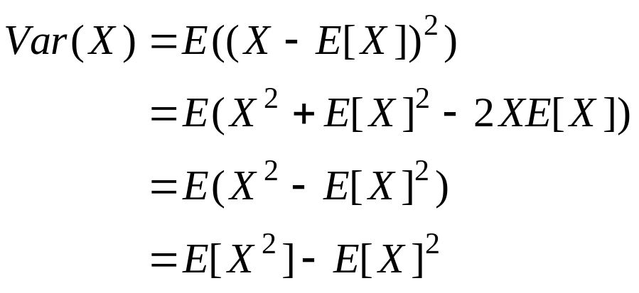
Variance
The variance of a random variable X is the expectation of (X-E[x])² :

Slide 34
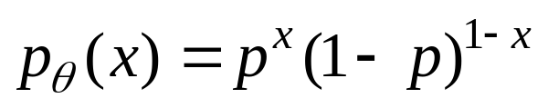
Bernoulli Distribution
The outcome of an experiment can either be success (i.e., 1) and failure (i.e., 0).
Pr(X=1) = p, Pr(X=0) = 1-p, or
E[X] = p, Var(X) = p(1-p)

Slide 35
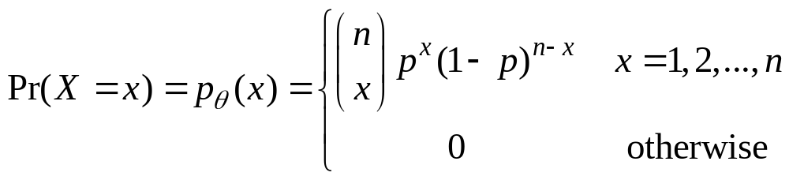
Binomial Distribution
n draws of a Bernoulli distribution
  X_{i}~Bernoulli(p), X=∑_{i=1}^{n} X_{i}, X~Bin(p, n)
Random variable X stands for the number of times that experiments are successful.
E[X] = np, Var(X) = np(1-p)

Slide 36
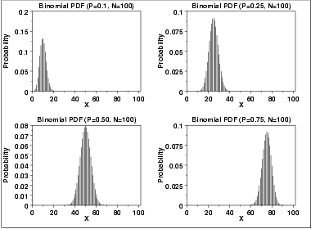
Plots of Binomial Distribution

Slide 37
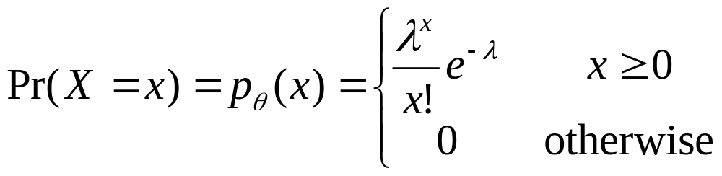
Poisson Distribution
Coming from Binomial distribution
  Fix the expectation λ=np
  Let the number of trials n→∞
  A Binomial distribution will become a Poisson distribution
E[X] = λ, Var(X) = λ

Slide 38
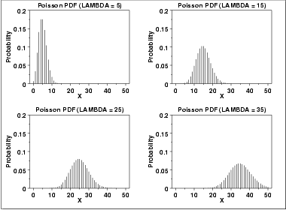
Plots of Poisson Distribution

Slide 39
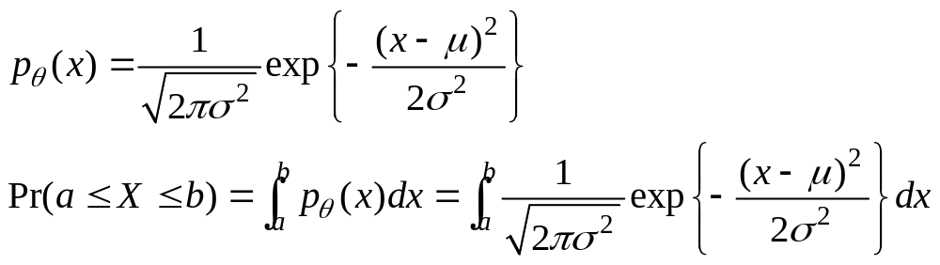
Normal (Gaussian) Distribution
X~N(μ,σ)
E[X]= μ, Var(X)= σ²
If X₁~N(μ₁,σ₁) and X₂~N(μ₂,σ₂), X= X₁+ X₂ ?

